Slide 1

Locators: DOM, CSS, XPath. Page Object Pattern
Vasilii Aleksandrov
11.2022

Slide 2
AGENDA
Types of Locators
Best practices for using Locators
Page Object Model
Page Factory
Best practices for POM

Slide 3
Strategies to locate Web Elements
from selenium import webdriver
from selenium.webdriver.common.by import By
driver.find_element(By.ID, 'ID')
driver.find_element(By.NAME, 'NAME')
driver.find_element(By.CLASS_NAME, 'CLASS_NAME')
driver.find_element(By.LINK_TEXT, 'LINK_TEXT')
driver.find_element(By.PARTIAL_LINK_TEXT, 'PARTIAL_LINK_TEXT')
driver.find_element(By.TAG_NAME, 'TAG_NAME')
driver.find_element(By.CSS_SELECTOR, 'CSS_SELECTOR')
driver.find_element(By.XPATH, 'XPATH')

Slide 4
Types of Locators

Slide 5
Types of Locators
DOM (Document Object Model)
in the HTML DOM, the Element object represents an HTML element,
like P, DIV, A, TABLE, or any other HTML element
XPath (XML Path Language)
XPath uses path expressions to select nodes or node-sets in an XML document. The node is selected by following a path or steps
CSS (Cascading Style Sheets)
CSS describes how HTML elements should be displayed

Slide 6
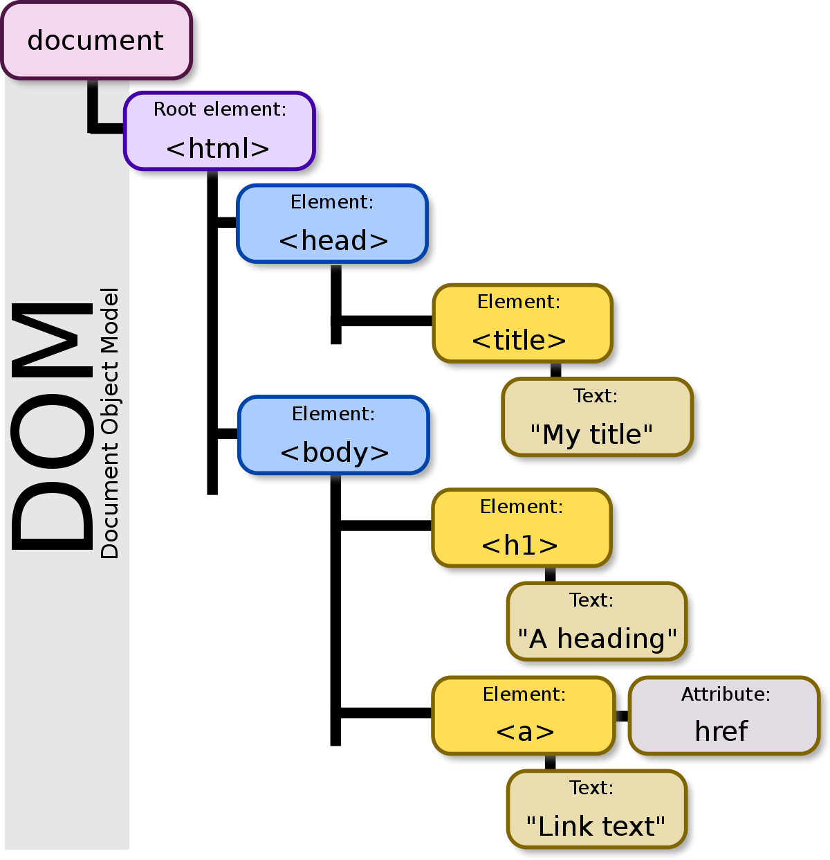
DOM Example
<span>
<a class=”j-class” name=”j-name”, id=”j-id”>Click here</a>
</span>
driver.find_element(By.ID, 'j-id')
driver.find_element(By.NAME, 'j-name’)
driver.find_element(By.CLASS_NAME, 'j-class')
driver.find_element(By.LINK_TEXT, 'Click here')
driver.find_element(By.PARTIAL_LINK_TEXT, 'here')
driver.find_element(By.TAG_NAME, 'a')

Slide 7
DOM pros and cons
Pros | Cons
Easy | Not enough flexible
Short | Can not move “Down the tree”
 | Can not move “Up the tree”
 | Can not search for tags
 | Can not search by other attributes
 | Can not search by text, if its not the text of the link
 | Can not select not the first item from the found

Slide 8
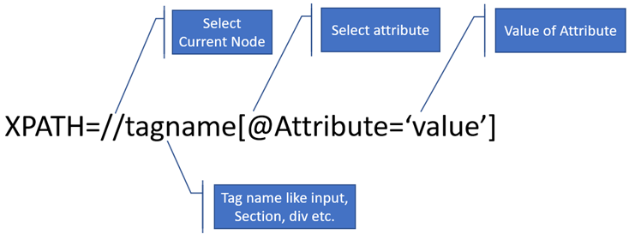
XPath Example
<span>
<a class=”j-class” name=”j-name”, id=”j-id”>Click here</a>
<a class=”j-class” name=”j-name”, id=”j-id”>Click here too</a>
</span>
driver.find_element(By.XPATH, "//span/a[@class=‘j-class’]") driver.find_element(By.XPATH, "//span/*[@class=‘j-class’]") driver.find_element(By.XPATH, "//*[@class=‘j-class’]") driver.find_element(By.XPATH, "//*[@class=‘j-class’][2]") driver.find_element(By.XPATH, "//a[@class=‘j-class’]") driver.find_element(By.XPATH, "//a[text()=‘Click here too’]") driver.find_element(By.XPATH, "//a[contains(text(), ‘here’]") driver.find_element(By.XPATH, "//span/*[contains(@class, ‘class’]") driver.find_element(By.XPATH, "//span/a[@class='j-class' and @name='j-name']")

Slide 9
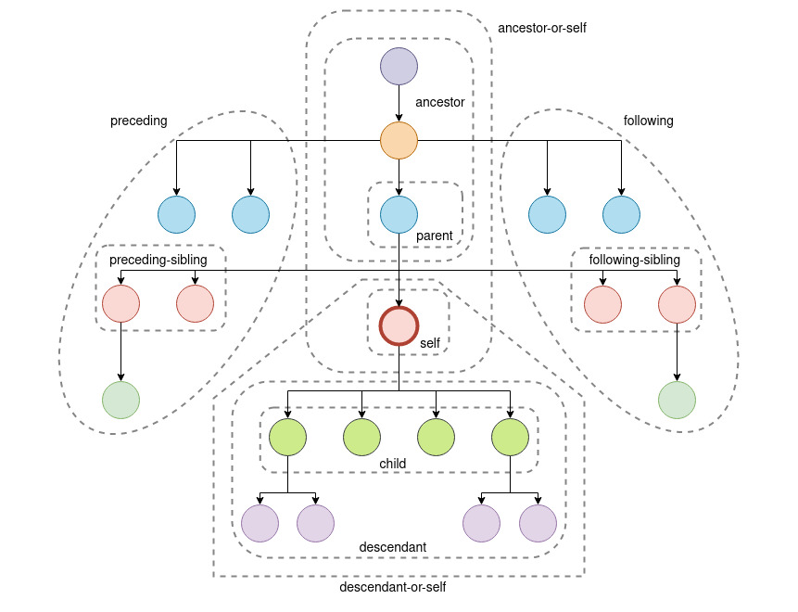
XPath Axes
Nodes: DOM represents trees of nodes. The topmost element of the tree is called root node. XPath contains seven kinds of nodes: element, attribute, text, namespace, processing-instruction, comment, and document nodes.
Atomic values: The node which has no parents or children is called atomic values.
Parents: Each element and attribute has one parent.
Children: Element nodes that may contain zero, one, or more children.
Siblings: The node that has the same parent is called siblings.
more info: https://www.w3schools.com/xml/xpath_syntax.asp
https://www.w3schools.com/xml/xpath_axes.asp

Slide 10
XPath Axes
An axis represents a relationship to the context (current) node and is used to locate nodes relative to that node on the tree
Axis Name | Description | Notes
ancestor | Selects all ancestors (parent, grandparent, etc.) of the current node
ancestor-or-self | Selects all ancestors (parent, grandparent, etc.) of the current node and the current node itself
attribute | Selects all attributes of the current node | @lang is short for attribute::lang
child | Selects all children of the current node | book is short for child::book
descendant | Selects all descendants (children, grandchildren, etc.) of the current node
descendant-or-self | Selects all descendants (children, grandchildren, etc.) of the current node and the current node itself | // is short for /descendant-or-self::node()/
following | Selects everything in the document after the closing tag of the current node
following-sibling | Selects all siblings after the current node
namespace | Selects all namespace nodes of the current node
parent | Selects the parent of the current node | .. is short for parent::node()
preceding | Selects all nodes that appear before the current node in the document, except ancestors, attribute nodes and namespace nodes
preceding-sibling | Selects all siblings before the current node
self | Selects the current node | . is short for self::node()

Slide 11
XPath pros and cons
Pros | Cons
Can find everything | Pretty slow
Can move Up and Down | Very long
Can search by text()
Can select element by index

Slide 12
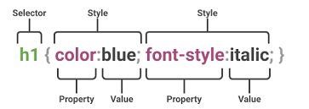
CSS Example
<span>
<a class=”j-class” name=”j-name”, id=”j-id”>Click here</a>
</span>
driver.find_element(By.CSS, ".j-class") driver.find_element(By.CSS, "#j-id") driver.find_element(By.CSS, "a[name='j-name']") driver.find_element(By.CSS, "[name^='j']")
driver.find_element(By.CSS, "[name$='name']")
driver.find_element(By.CSS, "[name*='name']")

Slide 13
CSS pros and cons
Pros | Cons
Easy and flexible | Can not search the text
Can move “Down the tree” | Can not move “Up the tree”
Can search for tags
Can search by other attributes
Combined search
Short

Slide 14
Best practices for using Locators

Slide 15
Good Locators
Use a unique ID for element identification
Avoid using IDs that change locations
Avoid elements that depend on auto-generated values
Keep your Locators short
Don’t use XPath or CSS selector provided by the Dev Tools
Choose type which appropriates to your case:
If in the context of such an element is one, it has an id or name unique for this context, then it's better to use DOM.
If you need to operate with several elements, but you can do without XPath, then it's better to use CSS (usually the best option)
If the locator is more intuitive and clearer with XPath (or you can not do without it), then even if you can do CSS or DOM, it's better to choose XPath. Visibility is more important.

Slide 16
Page Object Model

Slide 17
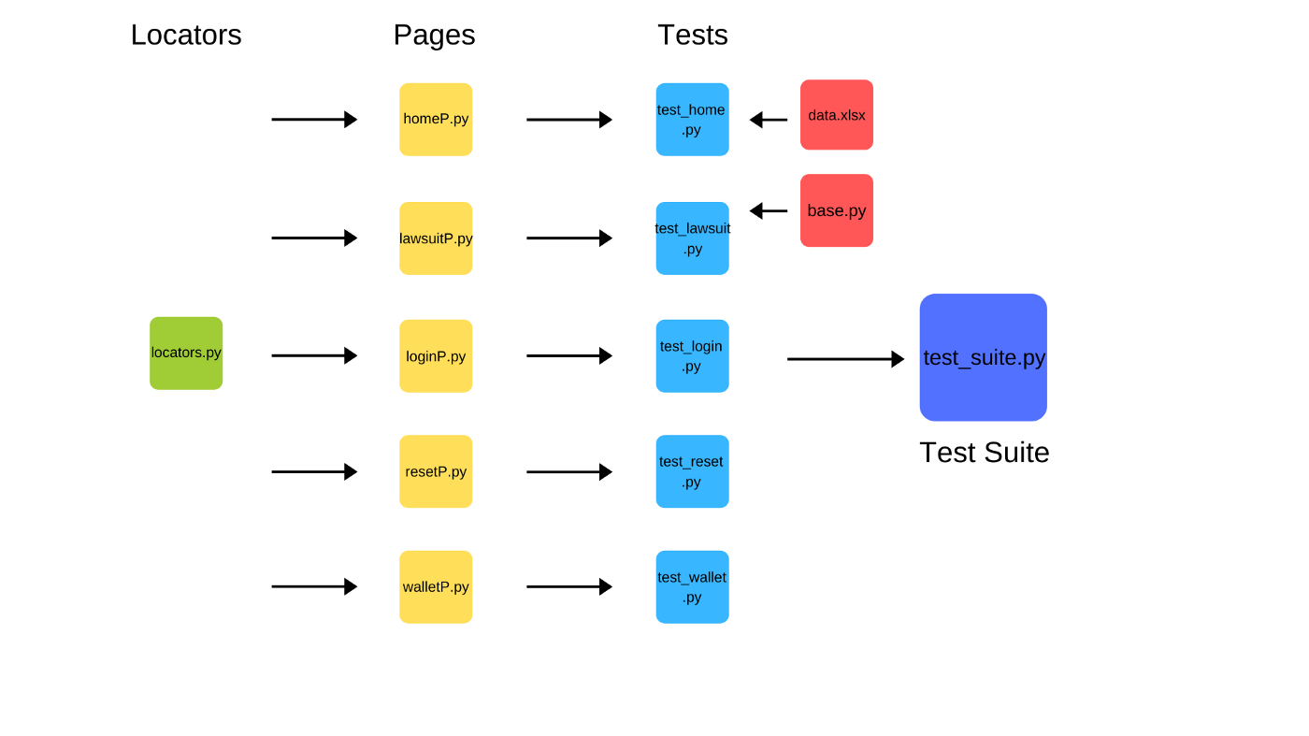
Page Object Model
Page Object Model is a design pattern where the core focus is on reducing code duplication and minimization of the effort involved in code update/maintenance. Under the Page Object Model, page classes are created for all the webpages that are a part of the Automation Under Test.

Slide 18
Simple Test without POM
driver.get("https://leetcode.com/accounts/login/") driver.find_element(By.NAME, 'login').send_keys("my_username") driver.find_element(By.NAME, 'password').send_keys("my_password") driver.find_element(By.ID, 'signin_btn').click()

Slide 19
Page Object Test
def test_login(browser): login_page = LoginPage.Login(browser) login_page.go_to_site() login_page.make_login("my_name", "my_password")

Slide 20
Page Object
class Locators: LOGIN_FIELD = (By.NAME, 'login') PASSWORD_FIELD = (By.NAME, 'password') SIGN_BUTTON = (By.ID, 'signin_btn') class Login(BasePage): def enter_login(self, value): return self.find_element(Locators.LOGIN_FIELD, time=5).send_keys(value) def enter_password(self, value): return self.find_element(Locators.PASSWORD_FIELD, time=5).send_keys(value) def click_on_sign_button(self): return self.find_element(Locators.SIGN_BUTTON, time=5).click() def make_login(self, name, password): self.enter_login(name) self.enter_password(password) self.click_on_sign_button()

Slide 21
Benefits of using Page Object Pattern
Easy to read test cases
Creating reusable code that can share across multiple test cases
Reducing the amount of duplicated code
If the user interface changes, the fix needs changes in only one place

Slide 22
Page Factory

Slide 23
What is Page Factory?
Page Factory is a method of implementing a Page Object Model. To support the Page Object pattern, we will declare all web elements in a dictionary.
Dictionary keys become WebElement or class member variables with having all extended WebElement methods.
Page Factory initializes all the web elements declared in Point at a time. All WebElements methods are re-defined to add extra features eg- the click method is extended to have an explicit wait for the element to be clickable.

Slide 24
Page Factory realization
pip install selenium-page-factory
from seleniumpagefactory.Pagefactory import PageFactory class LoginPage(PageFactory): def __init__(self,driver): self.driver = driver locators = { "login_field": ('NAME', 'login'), "password_field": ('NAME', 'password'), "sign_button": ('ID', 'signin_btn') } def make_login(self): self.login_field.set_text("my_name") self.password_field.set_text("my_password") self.sign_button.click_button()
from selenium import webdriver def test_login(): driver = webdriver.Chrome() driver.get("https://leetcode.com/accounts/login/") login = LoginPage(driver) login.make_login()

Slide 25
Best practices

Slide 26
Best practices
All assertions should be in tests or test steps
Separate test logic and test data
Use Abstract classes for extensions
Hold all specific constants as constants
Put all useful non-test-functional stuff into Utils class
Good naming of tests/methods/fields

Slide 27

Useful links
https://selenium-python.readthedocs.io/
https://www.selenium.dev/documentation/
https://selenium-page-factory.readthedocs.io/
https://www.browserstack.com/guide/page-object-model-in-selenium-python
https://saucelabs.com/resources/articles/selenium-tips-css-selectors
https://www.w3schools.com/xml/dom_nodetype.asp
https://www.w3schools.com/xml/xpath_intro.asp

Slide 28



Questions
Vasilii_Aleksandrov@epam.com
VAleksandrov91

